Slide 1
Semester-long Happiness Project
Tommy Clark Professor Michael Coppedge POLS 40815: Visualizing Politics May 6, 2024

Slide 2
Overarching Question:
What Brings People Happiness?

Slide 3
What Do We Mean By “Happiness”?
Life Satisfaction
Happiness
“The extent to which the individual enjoys life.” – Professor Benjamin Radcliff
Subjective Well-Being

Slide 4


How Do We Measure That?

Slide 5
What Kind of Factors Are We Looking At?
Personality Traits?
Fixed Factors?

Attainable conditions?

Slide 6
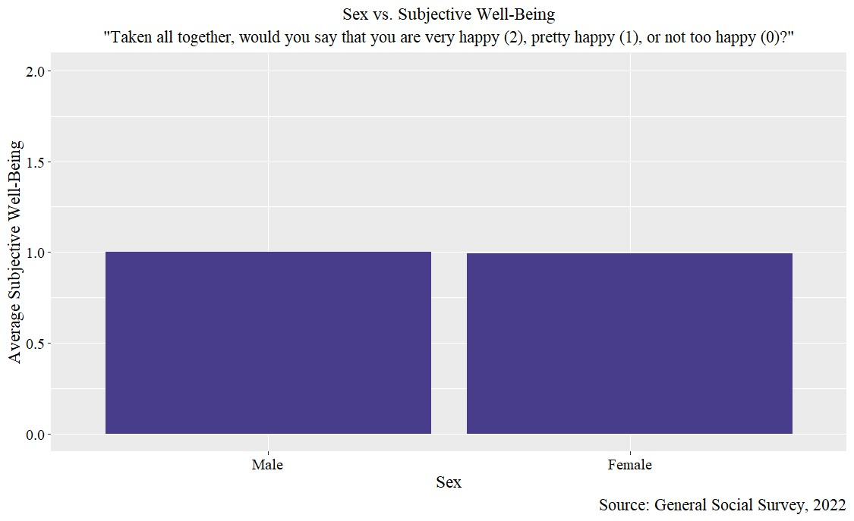

Slide 7
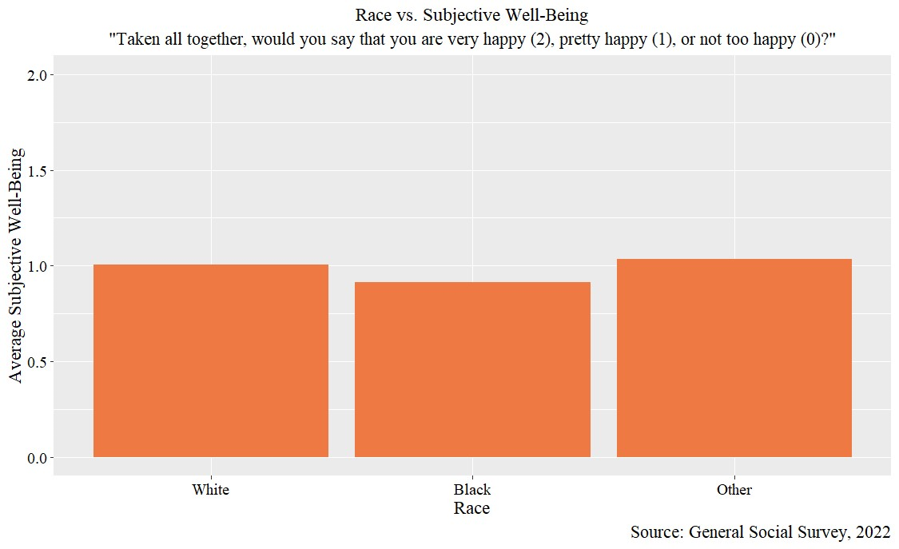

Slide 8
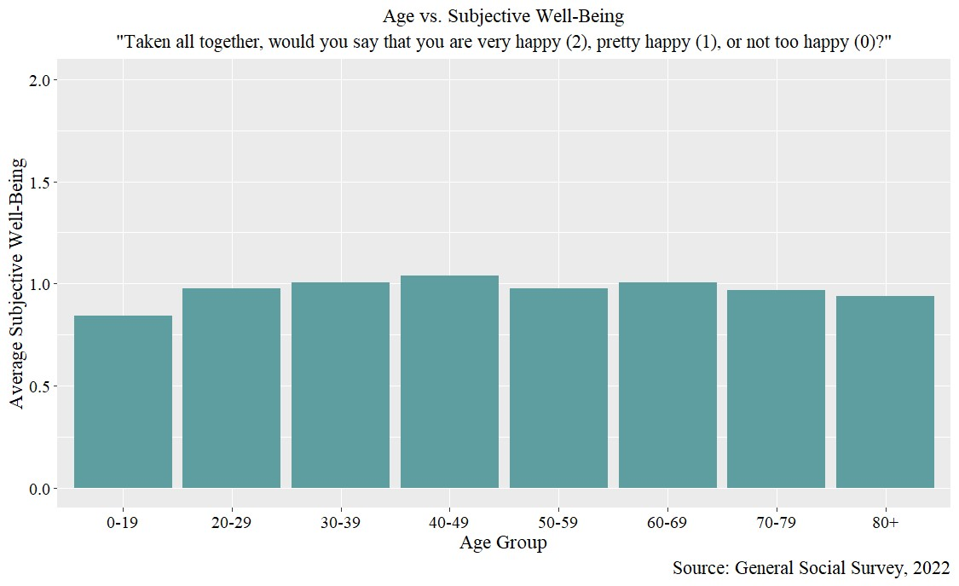

Slide 9
What People Think Will Make Them Happier…
More Money
Helping Others
Early Retirement
Finding Love

Slide 10
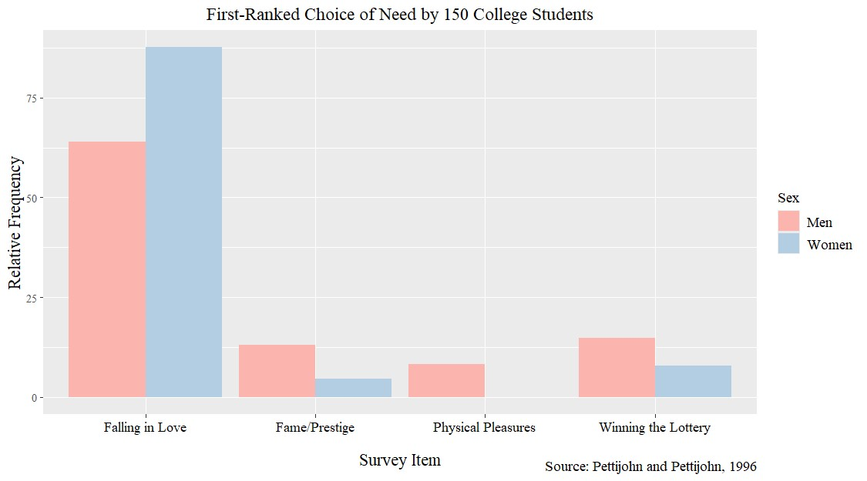

Slide 11
So, Do People Have It Right?

Slide 12
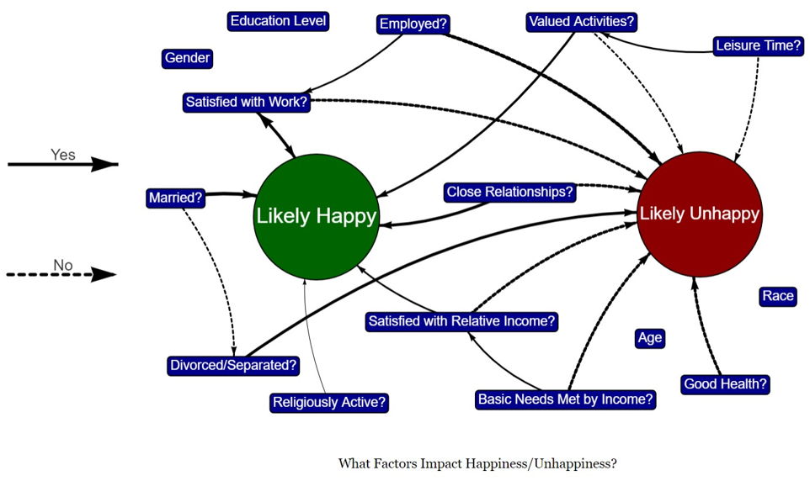

Slide 13
Income

Slide 14
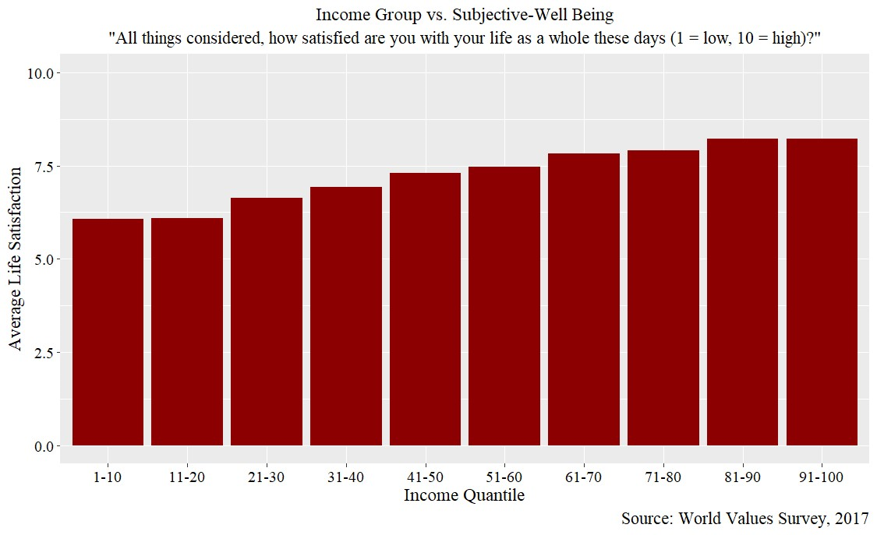

Slide 15
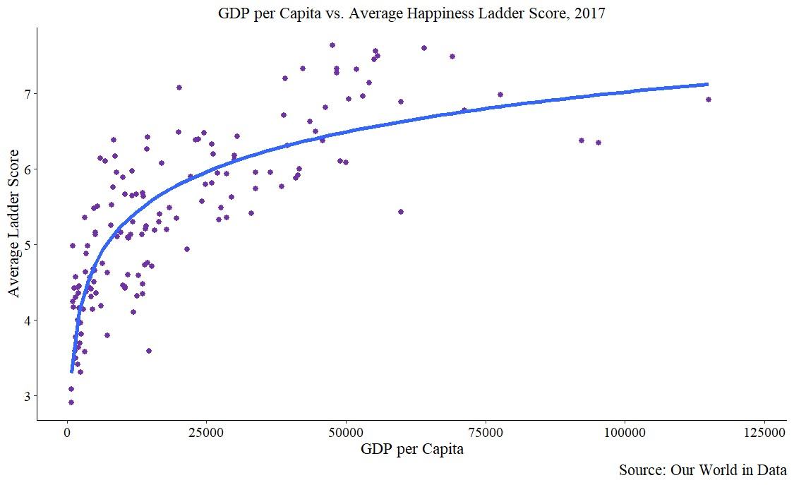

Slide 16
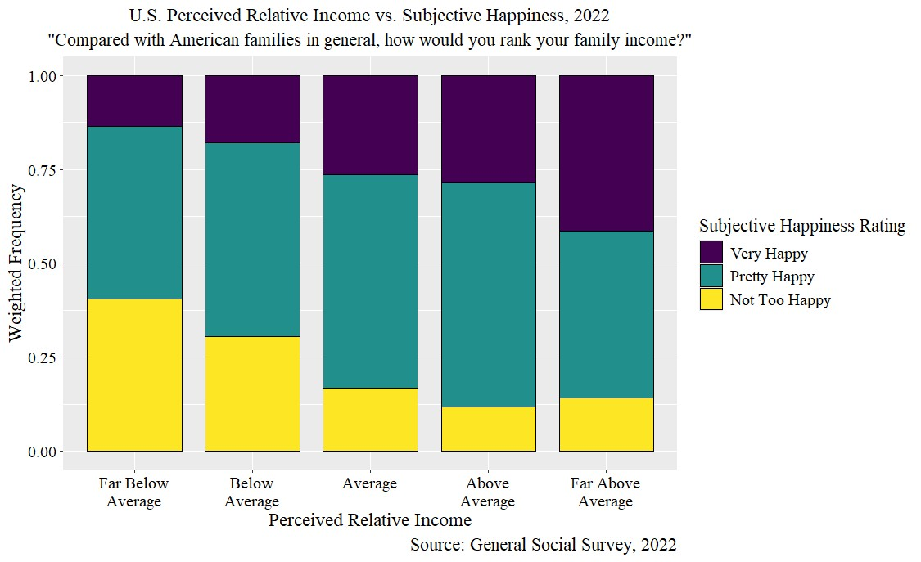

Slide 17
Work

Slide 18
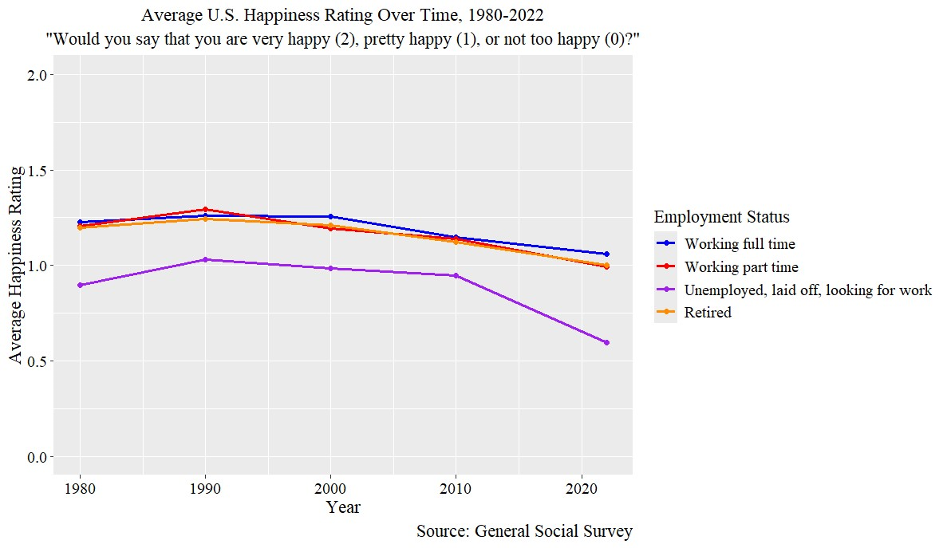

Slide 19
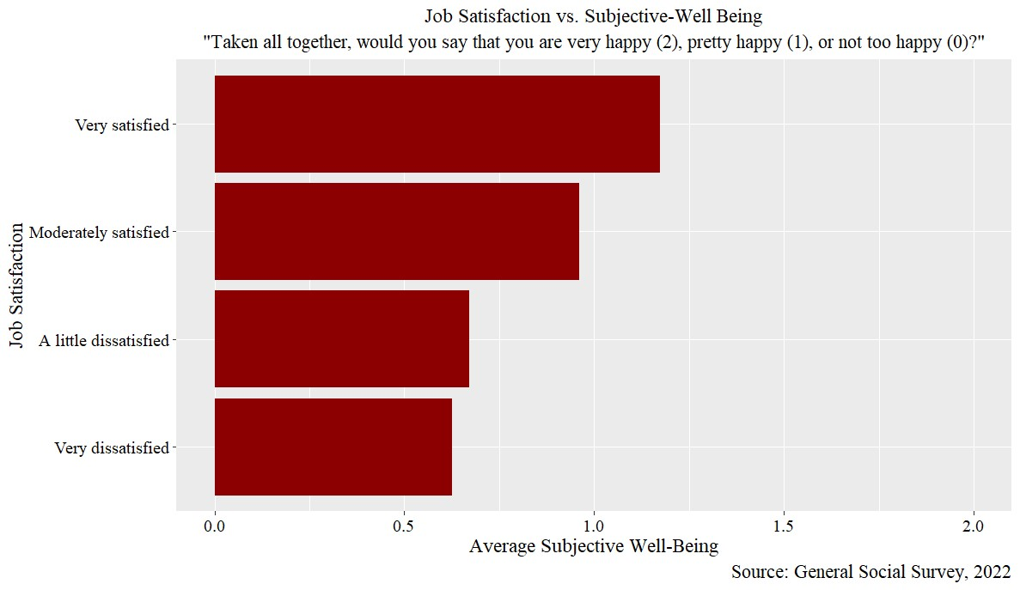

Slide 20
Marriage

Slide 21
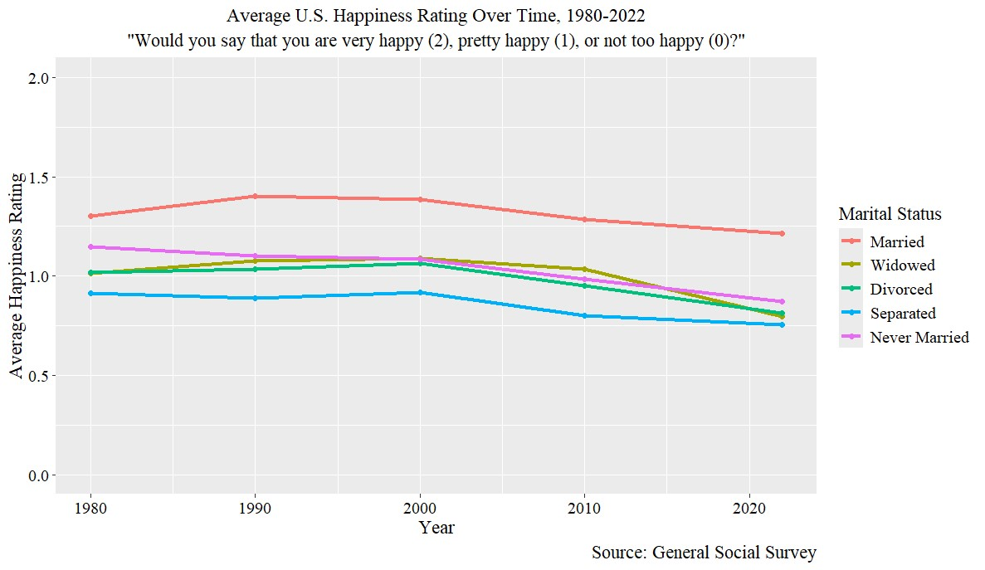

Slide 22
Main Takeaways for Individual-Level SWB

Slide 23
Get Married, Stay Married.
Don’t Underestimate Your Work.
Maintain Close Relationships.
Money Isn’t Everything.

Slide 24
National-Level SWB

Slide 25
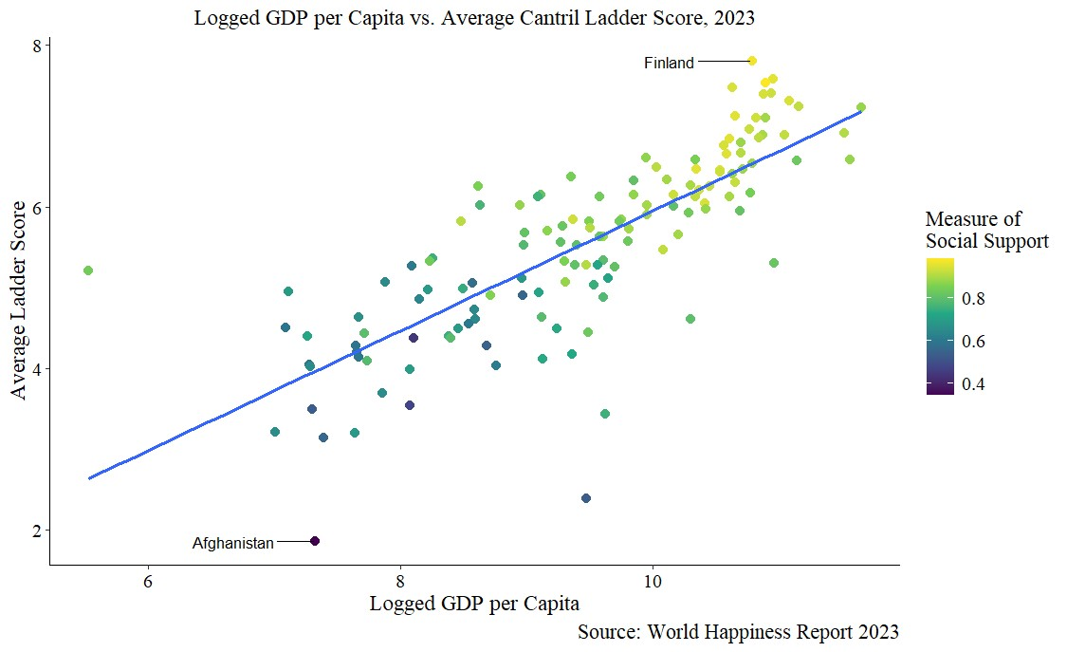

Slide 26
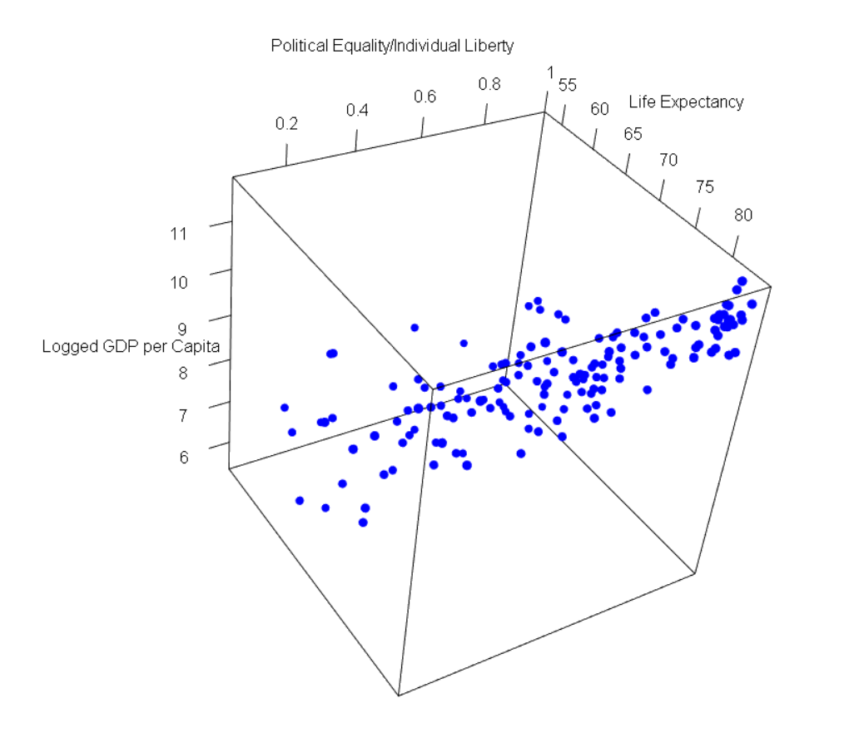

Slide 27
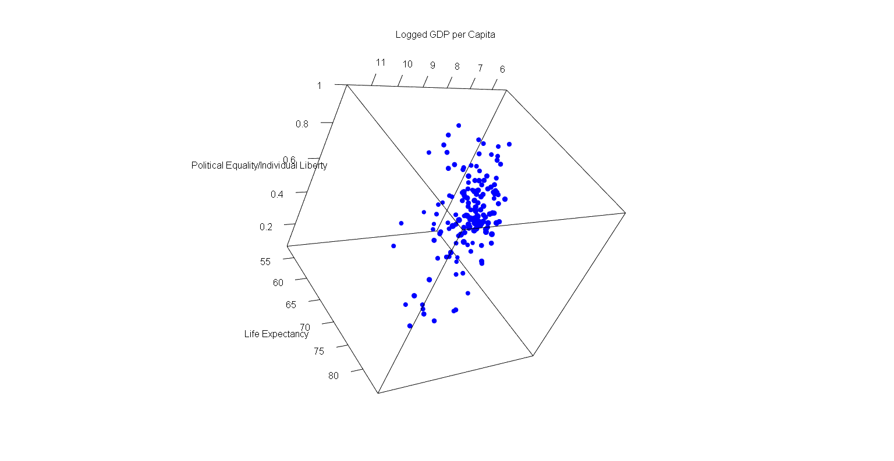

Slide 28
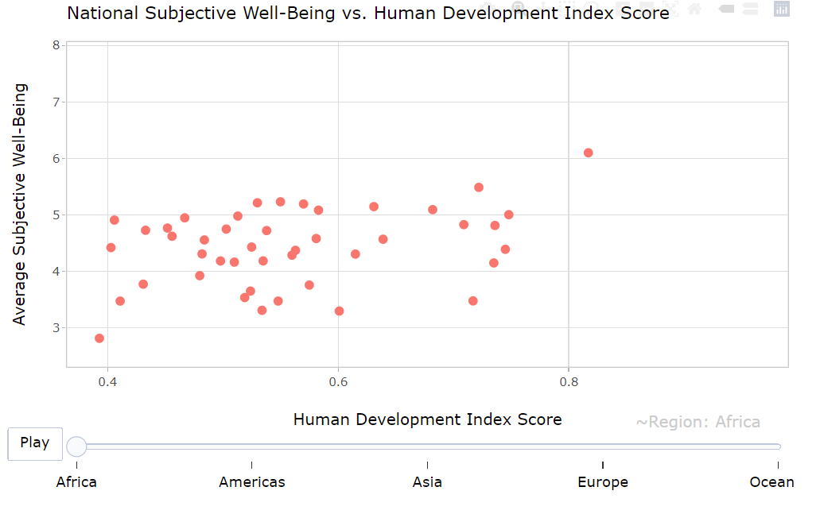

Slide 29
Takeaways for National-Level SWB

Slide 30
Stability
Economic Prosperity
Happiness

Slide 31
In Conclusion

Slide 32
Live in a stable country (duh!).
Stop striving for the future (money, early retirement, etc.).
Instead, strive for the here and now (relationships, work, stability, etc.)

Slide 33
Thank You!

Slide 34
Works Cited
Argyle, Michael, et al. “Causes and Correlates of Happiness.” Well-Being: The Foundations of Hedonic Psychology, Russell Sage Foundation, New York City, New York, 1999, pp. 353–373.
Benjamin, Daniel J et al. “What Do You Think Would Make You Happier? What Do You Think You Would Choose?” The American Economic Review vol. 102,5 (2012): 2083-2110. doi:10.1257/aer.102.5.2083.
Cantor, Nancy, et al. “Life Task Participation and Well-Being: The Importance of Taking Part in Daily Life.” Well-Being: The Foundations of Hedonic Psychology, Russell Sage Foundation, New York City, New York, 1999, pp. 230–243.
Coppedge et al. (2015, V-Dem Working Paper Series 2015:6). 2022. "V-Dem Dataset v12" Varieties of Democracy (V-Dem) Project. <https://doi.org/10.23696/vdemds22>.
Davern, Michael; Bautista, Rene; Freese, Jeremy; Herd, Pamela; and Morgan, Stephen L.; General Social Survey 1972-2024. [Machine-readable data file]. Principal Investigator, Michael Davern; Co-Principal Investigators, Rene Bautista, Jeremy Freese, Pamela Herd, and Stephen L. Morgan. Sponsored by National Science Foundation. NORC ed. Chicago: NORC, 2024: NORC at the University of Chicago [producer and distributor]. <gssdataexplorer.norc.org>.
Diener, Ed, et al. “National Differences in Subjective Well-Being.” Well-Being: The Foundations of Hedonic Psychology, Russell Sage Foundation, New York City, New York, 1999, pp. 434–450.
“GDP per capita (current US$).” The World Bank. 2021. Web. <https://data.worldbank.org/indicator/NY.GDP.PCAP.CD>.
“GDP per capita – World Bank” [dataset]. World Bank (2023) – with minor processing by Our World in Data. World Bank, “World Bank World Development Indicators” [original data]. <https://ourworldindata.org/grapher/gdp-vs-happiness?tab=table>.
Gertner, Jon. “The Futile Pursuit of Happiness.” The New York Times, 7 Sept. 2003, www.nytimes.com/2003/09/07/magazine/the-futile-pursuit-of-happiness.html.

Slide 35
Works Cited cont.
Haerpfer, C., Inglehart, R., Moreno, A., Welzel, C., Kizilova, K., Diez-Medrano J., M. Lagos, P. Norris, E. Ponarin & B. Puranen et al. (eds.). 2020. World Values Survey: Round Seven – Country-Pooled Datafile. Madrid, Spain & Vienna, Austria: JD Systems Institute & WVSA Secretariat. doi.org/10.14281/18241.1
Helliwell, J. F., Layard, R., Sachs, J. D., Aknin, L. B., De Neve, J.-E., & Wang, S. (Eds.). (2023). World Happiness Report 2023 (11th ed.). Sustainable Development Solutions Network. <https://worldhappiness.report/data/>.
Hofstede, Geert. “Dimension Data Matrix.” Geert Hofstede, 8 Dec. 2015, geerthofstede.com/research-and-vsm/dimension-data-matrix/.
"In Labor Force: Civilian: Unemployed, 2022.” Map. Social Explorer. Social Explorer, n.d. Web. 1 April 2024 at 18:24:33 GMT-4. (based on data from U.S. Census Bureau).
“Life expectancy at birth, total (years).” The World Bank. 2021. Web. <https://data.worldbank.org/indicator/SP.DYN.LE00.IN>.
Loewenstein, George, et al. “Wouldn’t It Be Nice? Predicting Future Feelings.” Well-Being: The Foundations of Hedonic Psychology, Russell Sage Foundation, New York City, New York, 1999, pp. 85–108.
Myers, David G., and Ed Diener. “Who Is Happy?” Psychological Science, vol. 6, no. 1, Jan. 1995, pp. 10–19.
Myers, David G., et al. “Close Relationships and Quality of Life.” Well-Being: The Foundations of Hedonic Psychology, Russell Sage Foundation, New York City, New York, 1999, pp. 374–391.
“Number of Deaths Due to Suicide Per 100 000 Population, 2022.” Social Explorer, (based on data from County Health Rankings & Roadmaps; accessed 1 April 2024 at 18:25:40 GMT-4).
Pettijohn, Terry F., and Terry F. Pettijohn. “Perceived Happiness of College Students Measured by Maslow’s Hierarchy of Needs.” Psychological Reports, vol. 79, no. 3, Dec. 1996, pp. 759–762.

Slide 36
Works Cited cont.
Radcliff, Benjamin. “The Scientific Study of Happiness.” The Political Economy of Human Happiness: How Voters’ Choices Determine the Quality of Life, Cambridge University Press, New York City, New York, 2013, pp. 77–109.
“Self-reported life satisfaction – World Happiness Report – World Happiness Report” [dataset]. World Happiness Report (2023) – processed by Our World in Data. World Happiness Report, “World Happiness Report (2023)” [original data]. <https://ourworldindata.org/grapher/gdp-vs-happiness?tab=table>.
“Share of people who are happy (World Value Survey 2014 - first and last waves)” [dataset]. World Values Survey (2014) – processed by Our World in Data. World Value Survey (2014) [original data]. <https://ourworldindata.org/grapher/share-who-say-happy-wvs-first-to-last>.
“Suicide mortality rate (per 100,000 population).” World Health Organization, Global Health Observatory Data Repository. The World Bank. 2015, 2019. <https://data.worldbank.org/indicator/SH.STA.SUIC.P5>.
“Things That Matter Survey: Results and Methodology.” Becoming Minimalist, 17 Mar. 2022, <www.becomingminimalist.com/things-that-matter-survey/>.
UNDP, Human Development Report (2024) – with minor processing by Our World in Data. “Human Development Index” [dataset]. UNDP, Human Development Report, “Human Development Report 2023-2024” [original data].
Warr, Peter, et al. “Well-Being and the Workplace.” Well-Being: The Foundations of Hedonic Psychology, Russell Sage Foundation, New York City, New York, 1999, pp. 392–412.
World Bank (2023) – with minor processing by Our World in Data. “GDP per capita – World Bank” [dataset]. World Bank, “World Bank World Development Indicators” [original data].
World Happiness Report (2023) – processed by Our World in Data. “Self-reported life satisfaction – World Happiness Report – World Happiness Report” [dataset]. World Happiness Report, “World Happiness Report (2023)” [original data].

Slide 37
Extra Graphs

Slide 38
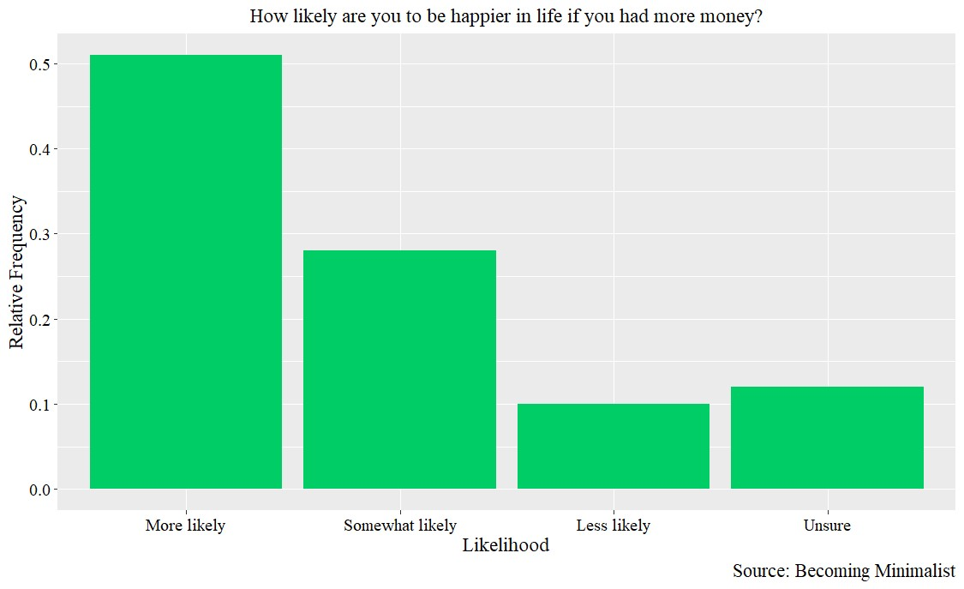

Slide 39
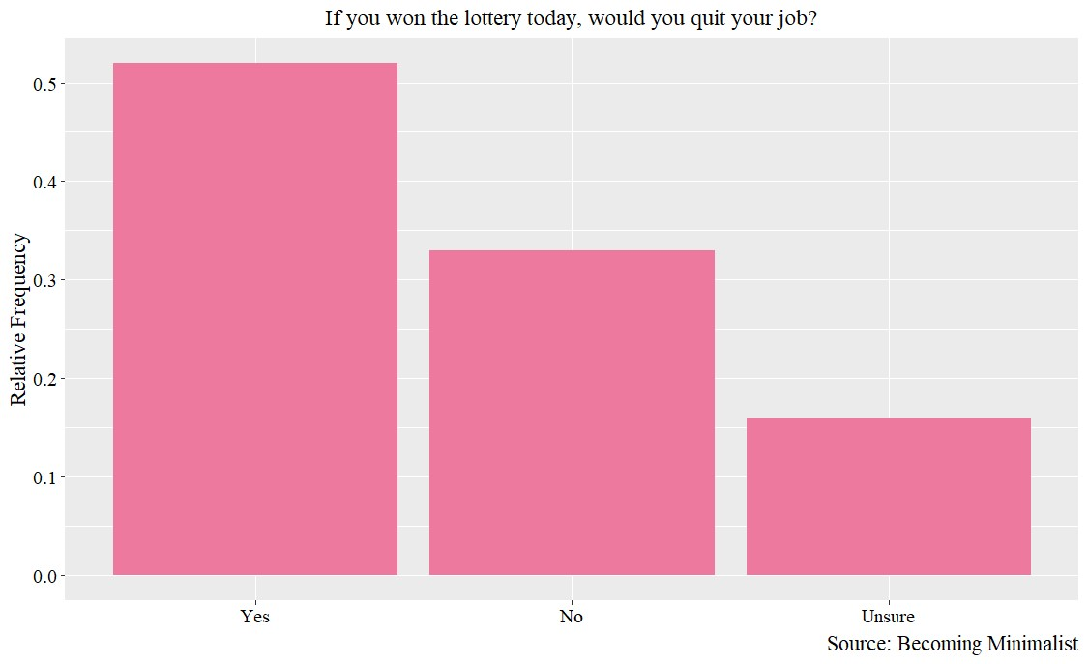

Slide 40
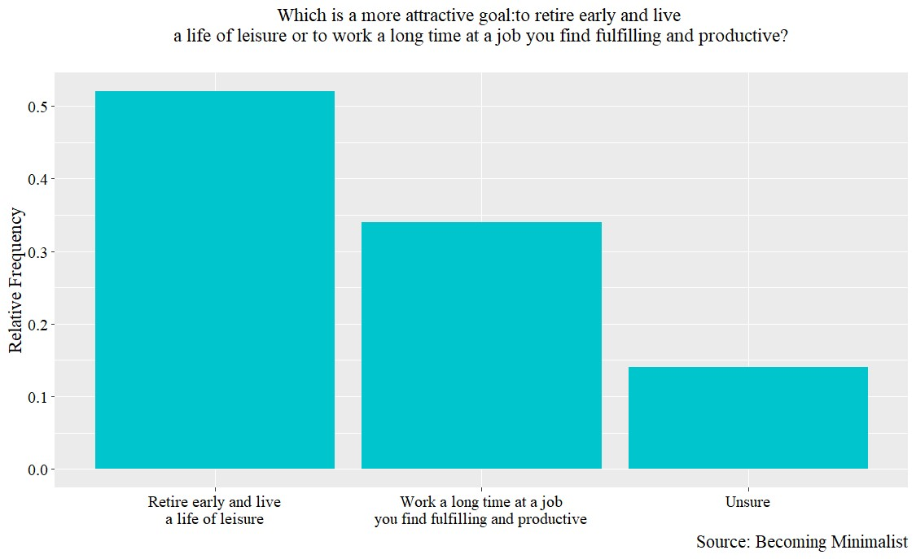

Slide 41
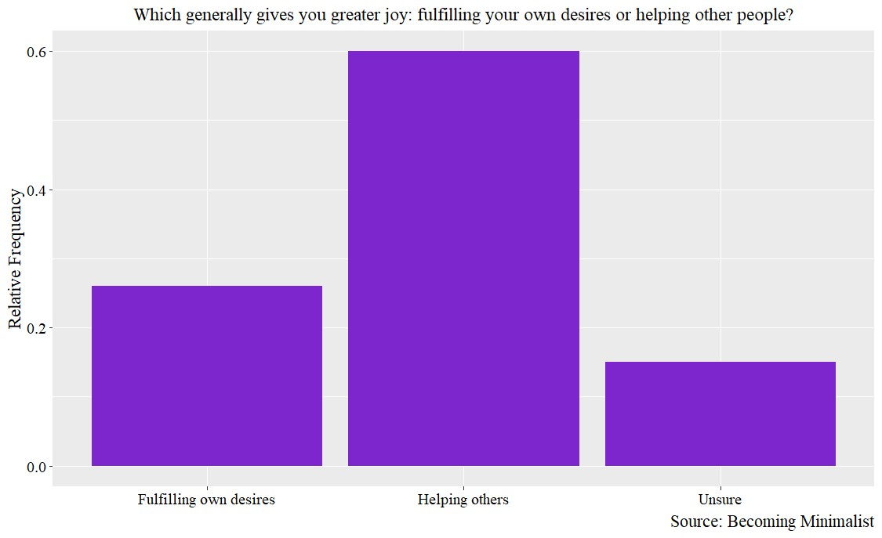

Slide 42
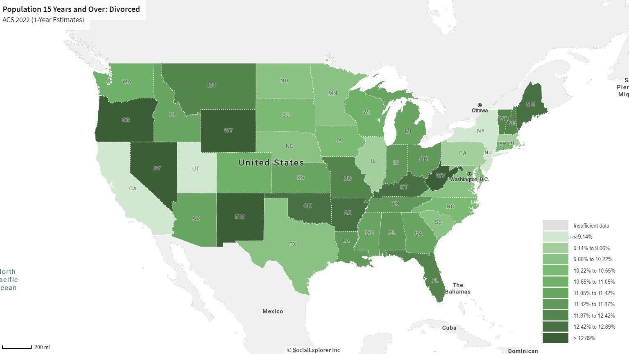

Slide 43
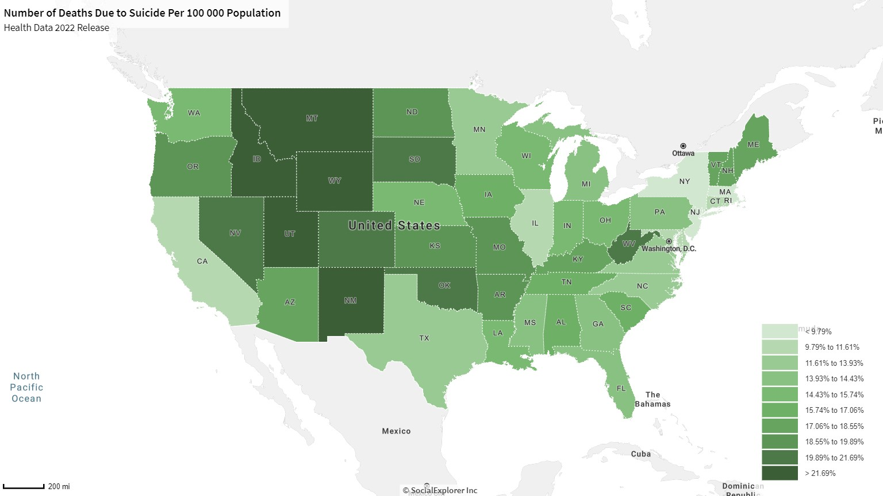

Slide 44
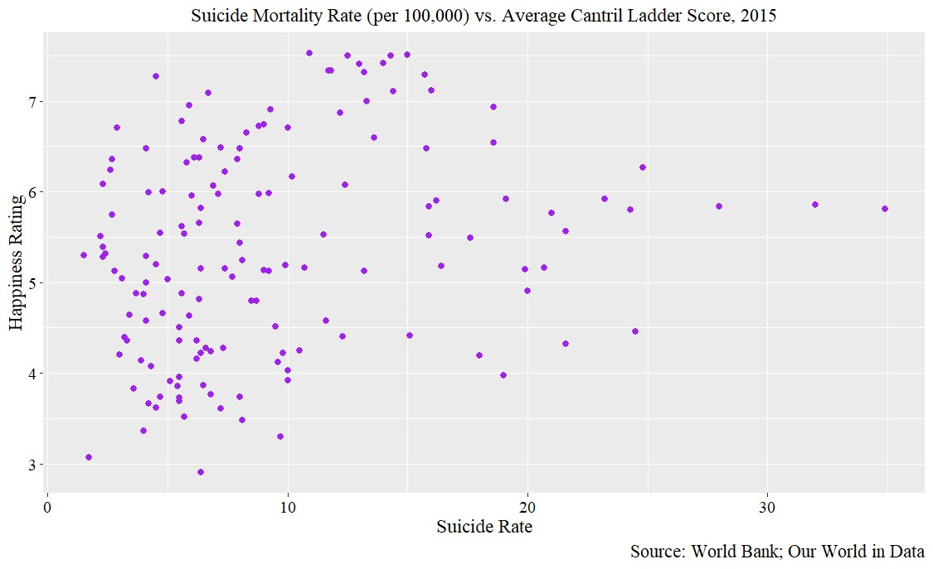

Slide 45
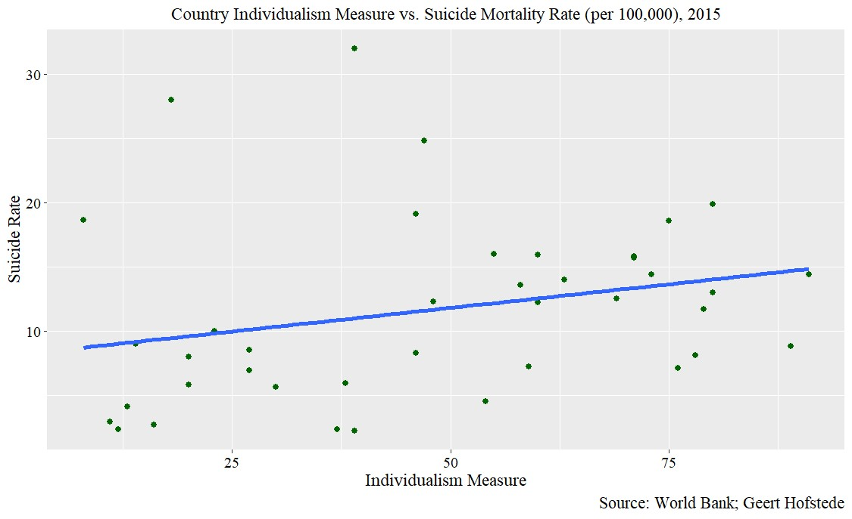

Slide 46
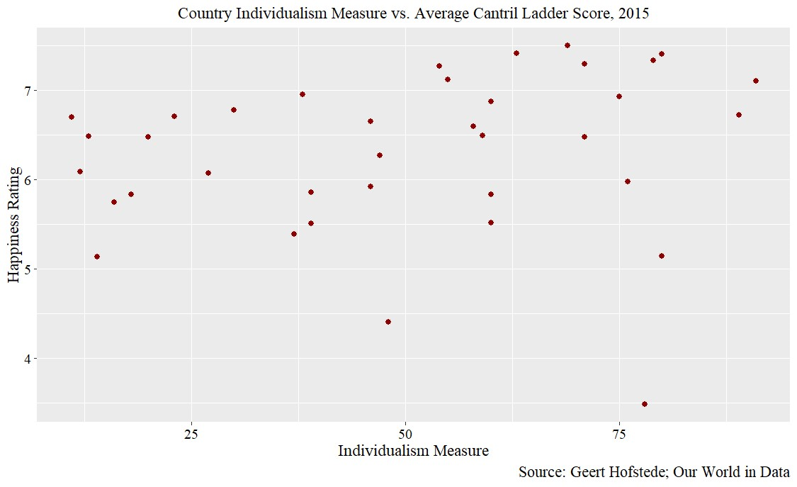

Slide 47
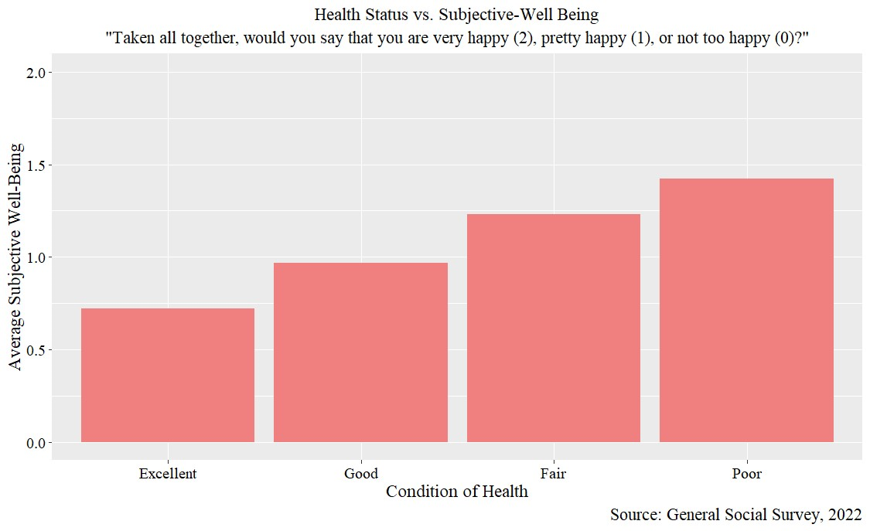

Slide 48
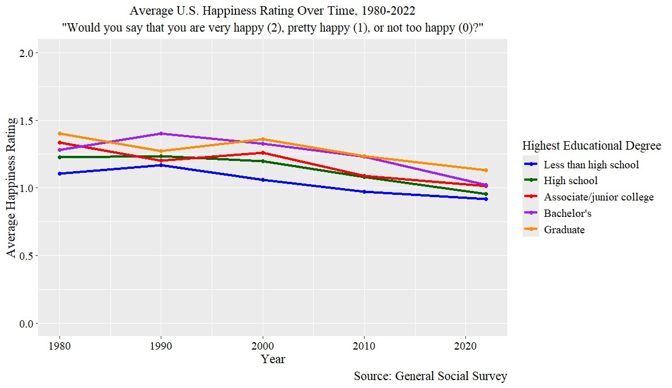

Slide 49
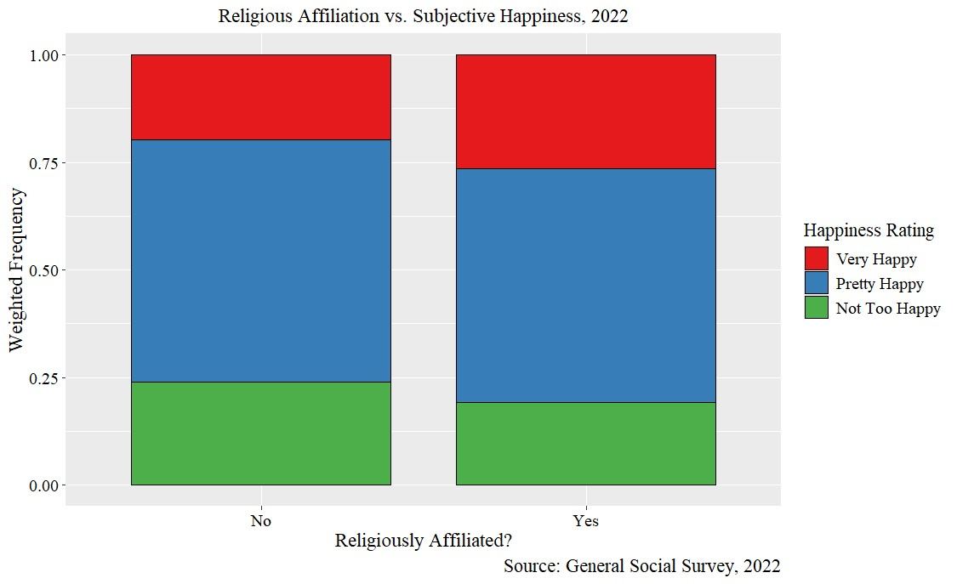

Slide 50
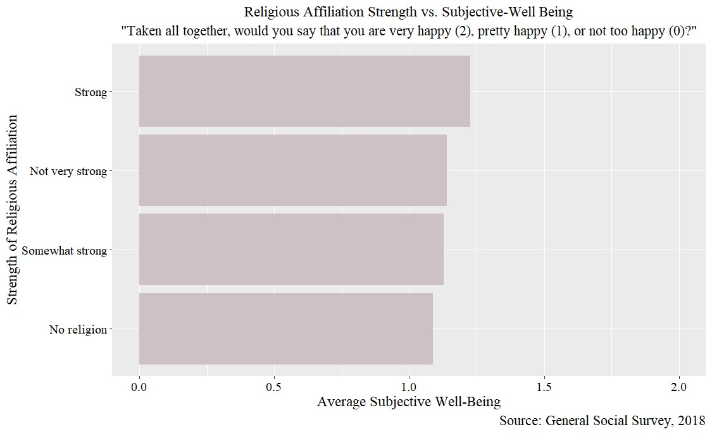

Slide 51
